Slide 1
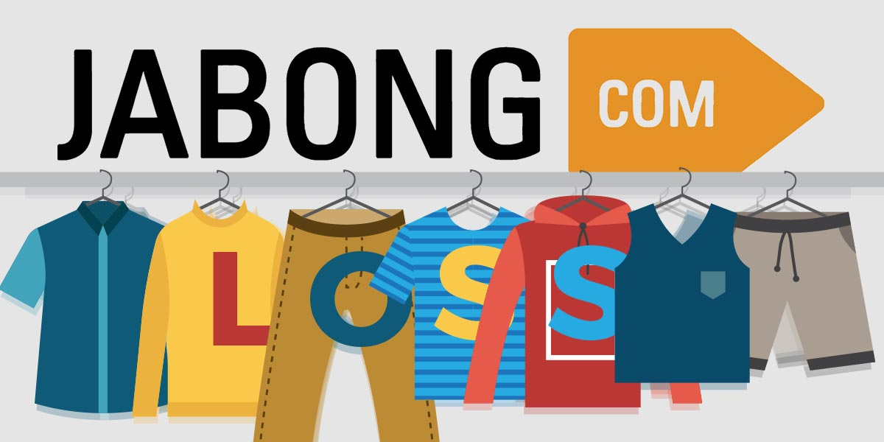

Slide 2
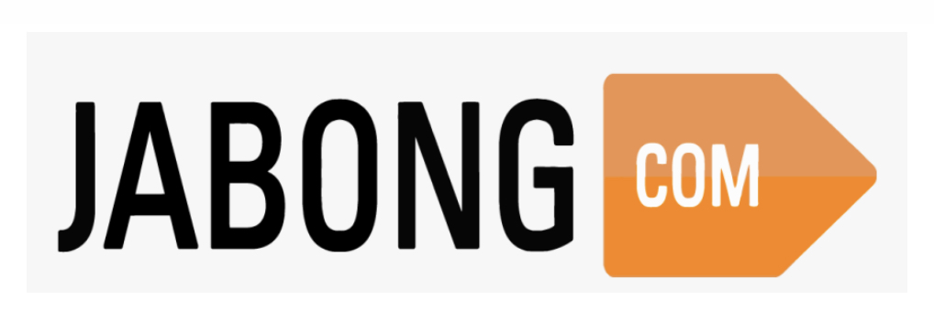
DETAILED ANALYSIS ON WHY
FAILED

Slide 3
KEY POINTS
1) TEAM
2) ABOUT JABONG
3) ABOUT JABONG MARKET
4) JABONG FAILURE CAUSE AND EFFECT ANALYSIS
5) WHAT COULD BE DONE DIFFERENTLY

Slide 4





OUR TEAM MEMBERS
KANANI RAJ
JOGENDRA SINGH MERTIYA
ANUBHAB DEBNATH
PIKESH TIWARI

Slide 5
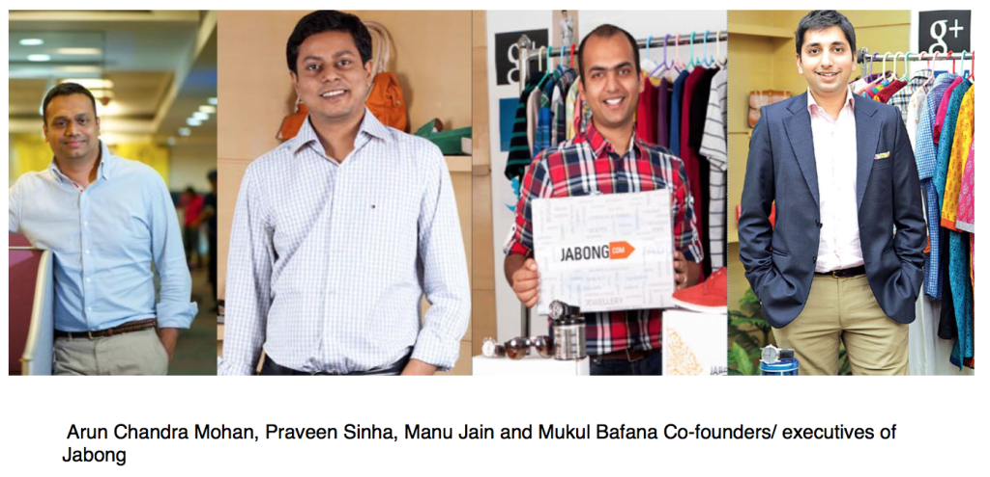
WHAT WAS JABONG?
Jabong was an Indian online fashion and lifestyle retailer e-commerce portal founded by Praveen Sinha, Lakshmi Potluri, Arun Chandra Mohan and Manu Kumar Jain that was founded in 2012. It was headquartered in Gurugram, India and operated in multiple countries including India, United Kingdom, and United States.

Slide 6
FINANCIAL
In March 2013, Jabong was dispatching over 6,000 orders a day. According to The Economist, Jabong clocked gross sales of around 100 –150 US million Dollars in 2012.
As per a Rocket Internet investor presentation, Jabong had a net revenue of 32.6 million euros in Q1 2016, up 14% from 28.6 million euros in the year-ago period. For FY2015, its revenues were at 122.1 million euros In September 2017
EMPLOYEES AND STACK-HOLDERS AND INVESTORS
The company had over 1,500 employees and had a wide range of stakeholders including investors and shareholders.

Slide 7
WHAT WAS JABONG’S REVENUE MODEL ?
Jabong's revenue model was based on the sale of fashion and lifestyle products through its online platform.
The company offered a wide range of products including clothing, footwear, accessories, and home decor.
They also had a strong focus on providing customers with a personalized shopping experience by offering a wide range of options and a user-friendly website.

Slide 8
CUSTOMER ANALYSIS
In terms of customer analysis, Jabong primarily targeted the youth and young adult demographic in India and other countries.
The company also had a strong focus on providing customers with a wide range of options and a personalized shopping experience.
They also offered a wide range of payment options, including cash on delivery and easy returns, to cater to the needs of the Indian market.

Slide 9

SOCIOECONOMIC FACTORS FACED BY JABONG
Jabong faced intense competition in the Indian e-commerce market, as well as challenges related to logistics and delivery infrastructure in India.

Slide 10
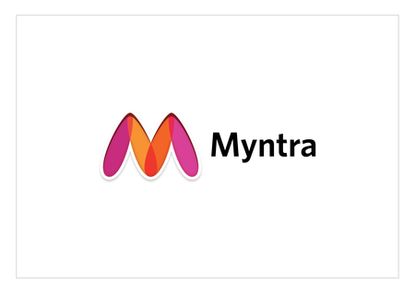

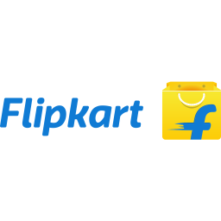

WHO WERE JABONG’S KEY COMPETITORS ?

Slide 11
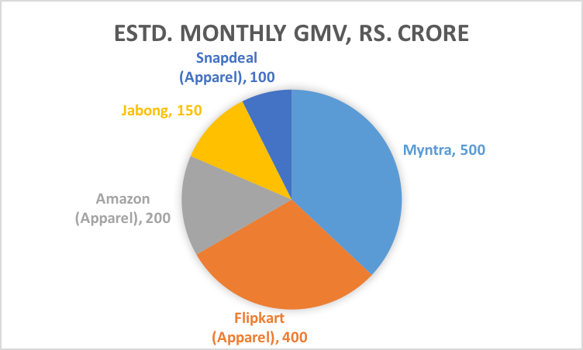

Slide 12
POSITION OF JABONG COMPARED TO IT’S COMPETITORS
Jabong's position in the market compared to other competitors varied over time. At its launch, Jabong was considered a strong player in the Indian e-commerce market, but in the years leading up to its acquisition by Flipkart, it struggled to maintain its market share as competition intensified.
PR AND MEDIA
As for PR and Media, Jabong primarily focused on leveraging digital marketing and social media to increase brand awareness and drive sales. The company also partnered with fashion influencers and celebrities to promote its products and increase its products and increase its reach among target audiences.

Slide 13
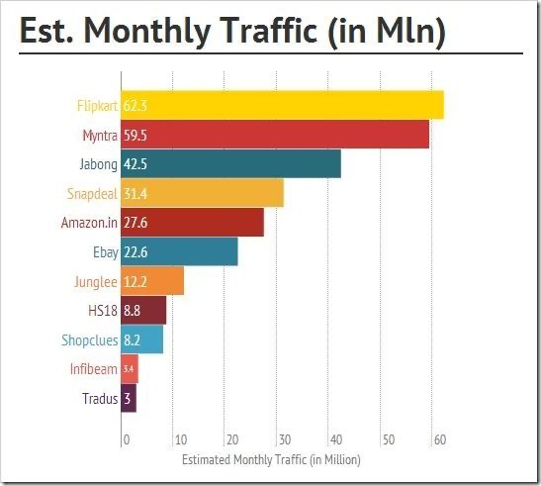

Slide 14
POSSIBLE CAUSES OF JABONG’S FAILURE
The failure of Jabong can be attributed to a combination of factors, including the emergence of new competitors in the market, PR or media reputation damage, socioeconomic causes, and poor business decisions made to cope with market demand. There could be four major causes like -
New competitor in Market
PR or Media reputation damage
Socioeconomic causes
Business Decisions to cope up with the market demand

Slide 15
New Competitors:
The Indian e-commerce market was highly competitive, and new players entered the market regularly. Jabong struggled to maintain its market share as competition intensified.
It also did’nt have a USP(Unique Selling Product).
PR or Media Reputation Damage:
Jabong struggled with negative publicity and a damaged reputation in the media. This may have contributed to a decline in customer trust and loyalty.
Socioeconomic Causes:
The Indian e-commerce market faced a number of socioeconomic challenges, including poor logistics and delivery infrastructure, which made it difficult for Jabong to maintain the level of service and customer satisfaction that it needed to remain competitive
Business Decisions:
Jabong struggled to keep up with the market demand. Business decisions like not keeping up with the market trends, not expanding the product line, not focusing on customer service, and not being able to sustain with the price war were some of the reasons for its failure.
All the founders left too frequently which lead to the overall imbalance in the company.
Overall, Jabong's failure can be attributed to a combination of internal and external factors, including intense competition, poor business decisions, and socioeconomic challenges.

Slide 16
WHAT COULD HAVE BEEN DONE DIFFERENTLY ?
Imagine we are a key decision maker for Jabong, What could you have done differently that could have saved the business.
If I were a key decision maker for Jabong, some actions I could have taken to potentially to save the business would include -
Focusing on customer experience
Innovation and Diversifying product line
Investing in Marketing and Branding
Building strong partnerships
Cost optimization
Developing a robust and efficient supply chain

Slide 17
Focusing on customer experience:
Prioritizing customer satisfaction and experience could have helped Jabong to build and maintain a loyal customer base. This could have been achieved by investing in better logistics and delivery infrastructure, and by providing better customer service.
Innovation and Diversifying product line:
Diversifying product line, keep an eye on market trends and introducing new products and services that align with those trends could have helped Jabong to attract new customers and retain existing ones
Investing in Marketing and Branding:
Investing in marketing and branding efforts to build a strong, positive reputation and increase brand awareness could have helped Jabong to stand out in a crowded marketplace.

Slide 18
Building strong partnerships:
Building strong partnerships with other companies, such as fashion brands, retailers, and technology companies, could have helped Jabong to gain access to new markets and customers, as well as to leverage the expertise and resources of those partners.
Cost optimization:
Reviewing the entire business operation and identifying areas for cost optimization to sustain in the price war and remain competitive.
Developing a robust and efficient supply chain to ensure timely delivery of products and to minimize delays, lost or damaged items.
Overall:
taking a holistic approach to addressing the business challenges, focusing on customer experience, innovation and diversifying product line, investing in marketing and branding, building strong partnerships and cost optimization could have helped Jabong to maintain its market share and remain competitive in the Indian e-commerce market.

Slide 19
Thank you FOR BEING PATIENT WE ARE NOW OPEN FOR ANY QUETIONS YOU MAY HAVE
AND LAST OF ALL

